Slide 1
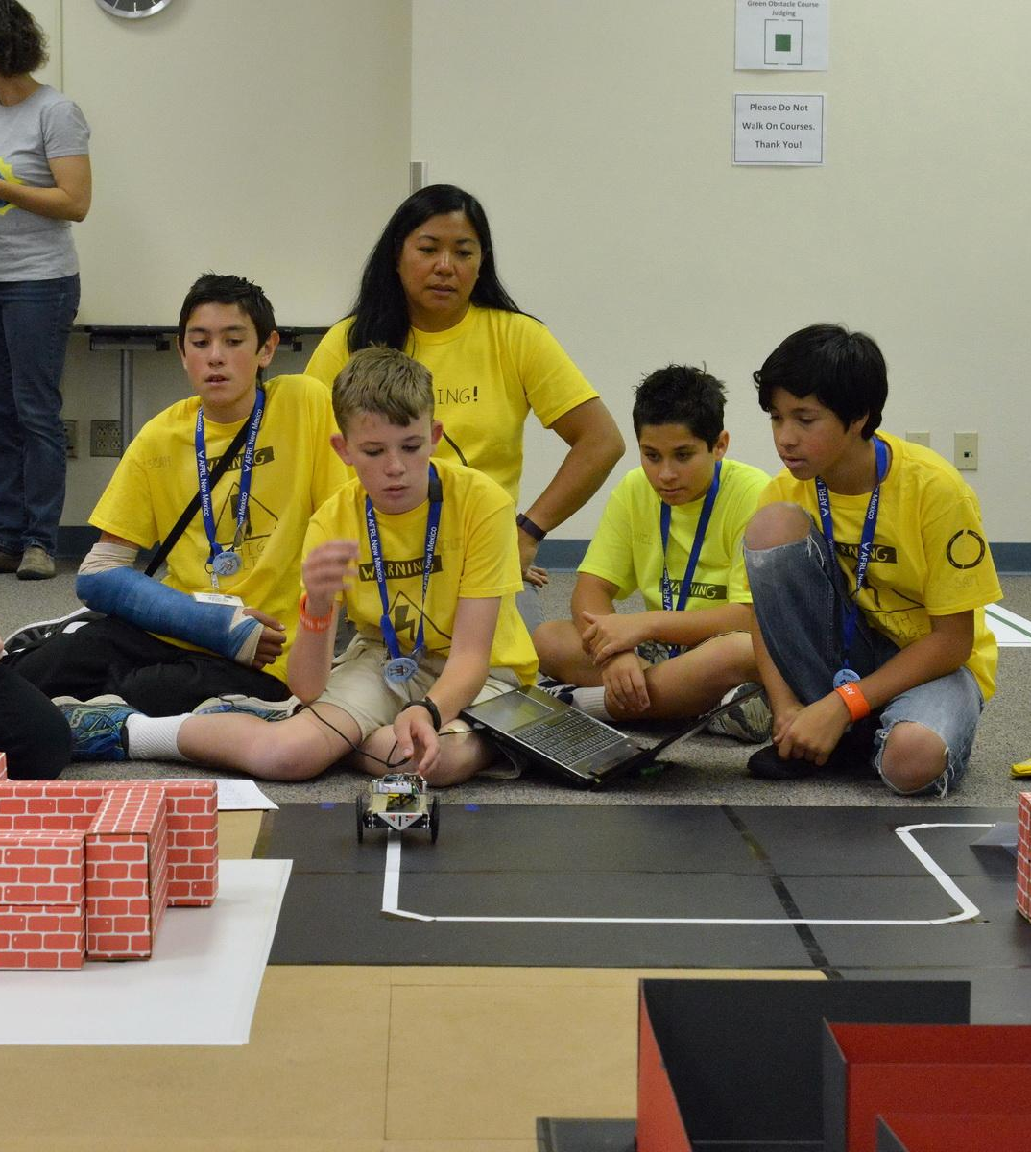
Gifted & Talented Parent Group
March 4th, 2019

Slide 2
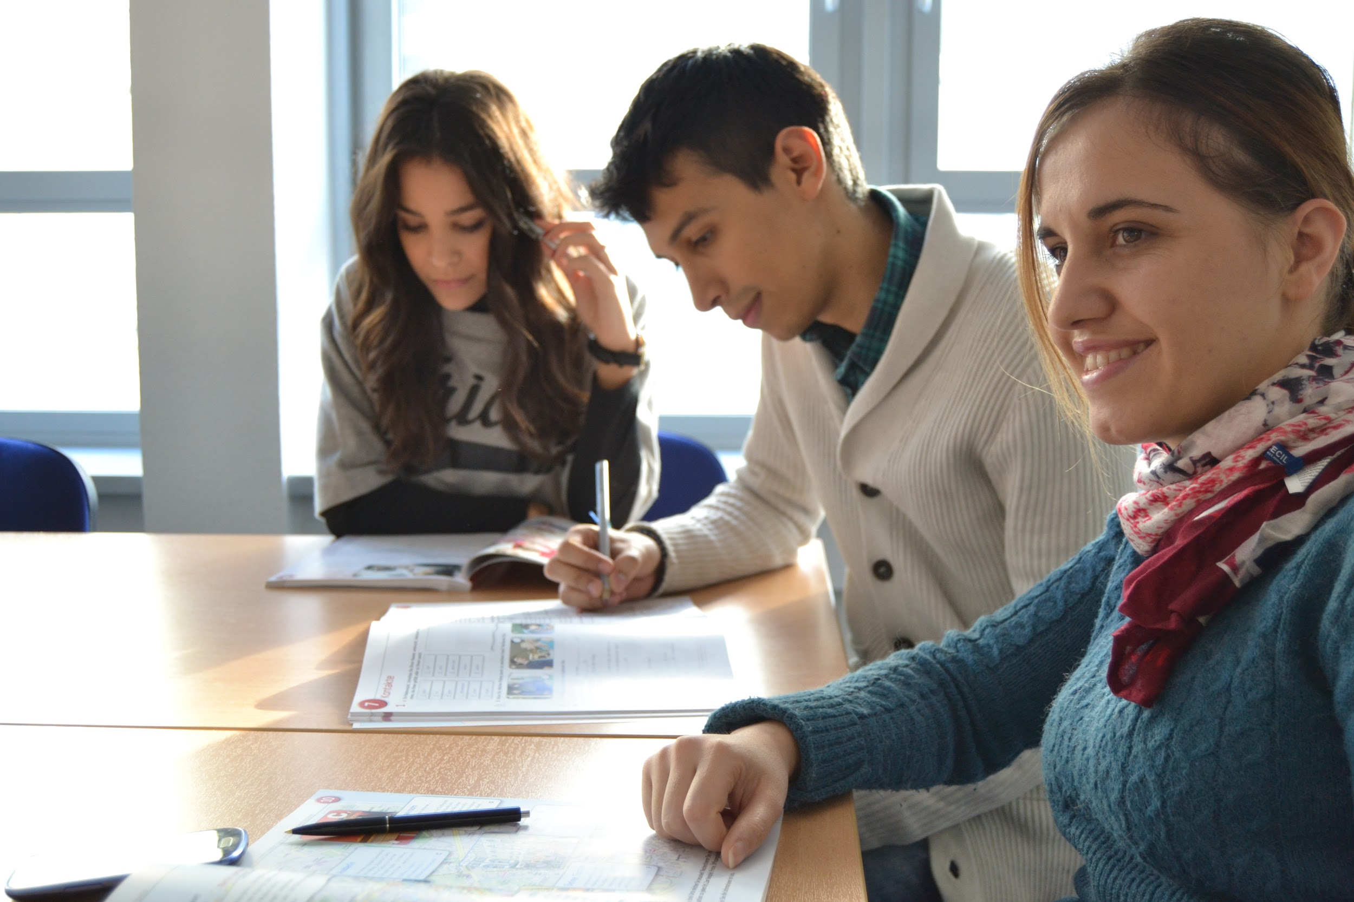
Goals of a Gifted & Talented Parent Group
Help parents advocate for their student in the classroom
Address educational needs of gifted students
Connect parents
Provide resources for parents

Slide 3
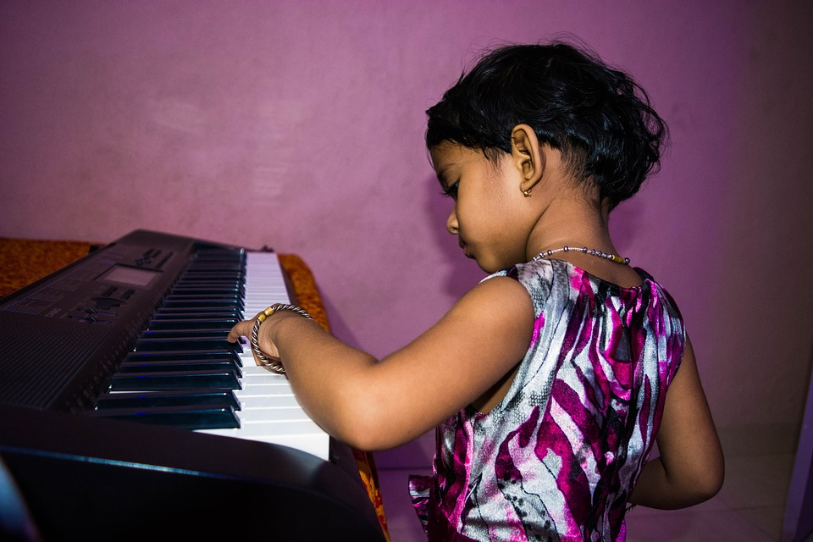
What is Gifted & Talented?
Identification Areas:
General Intellectual Ability
Math
Reading
Science
Social Studies
World Languages
Writing
Creative or productive thinking
Dance
Leadership
Music
Performing arts
Visual arts
psychomotor

Slide 4
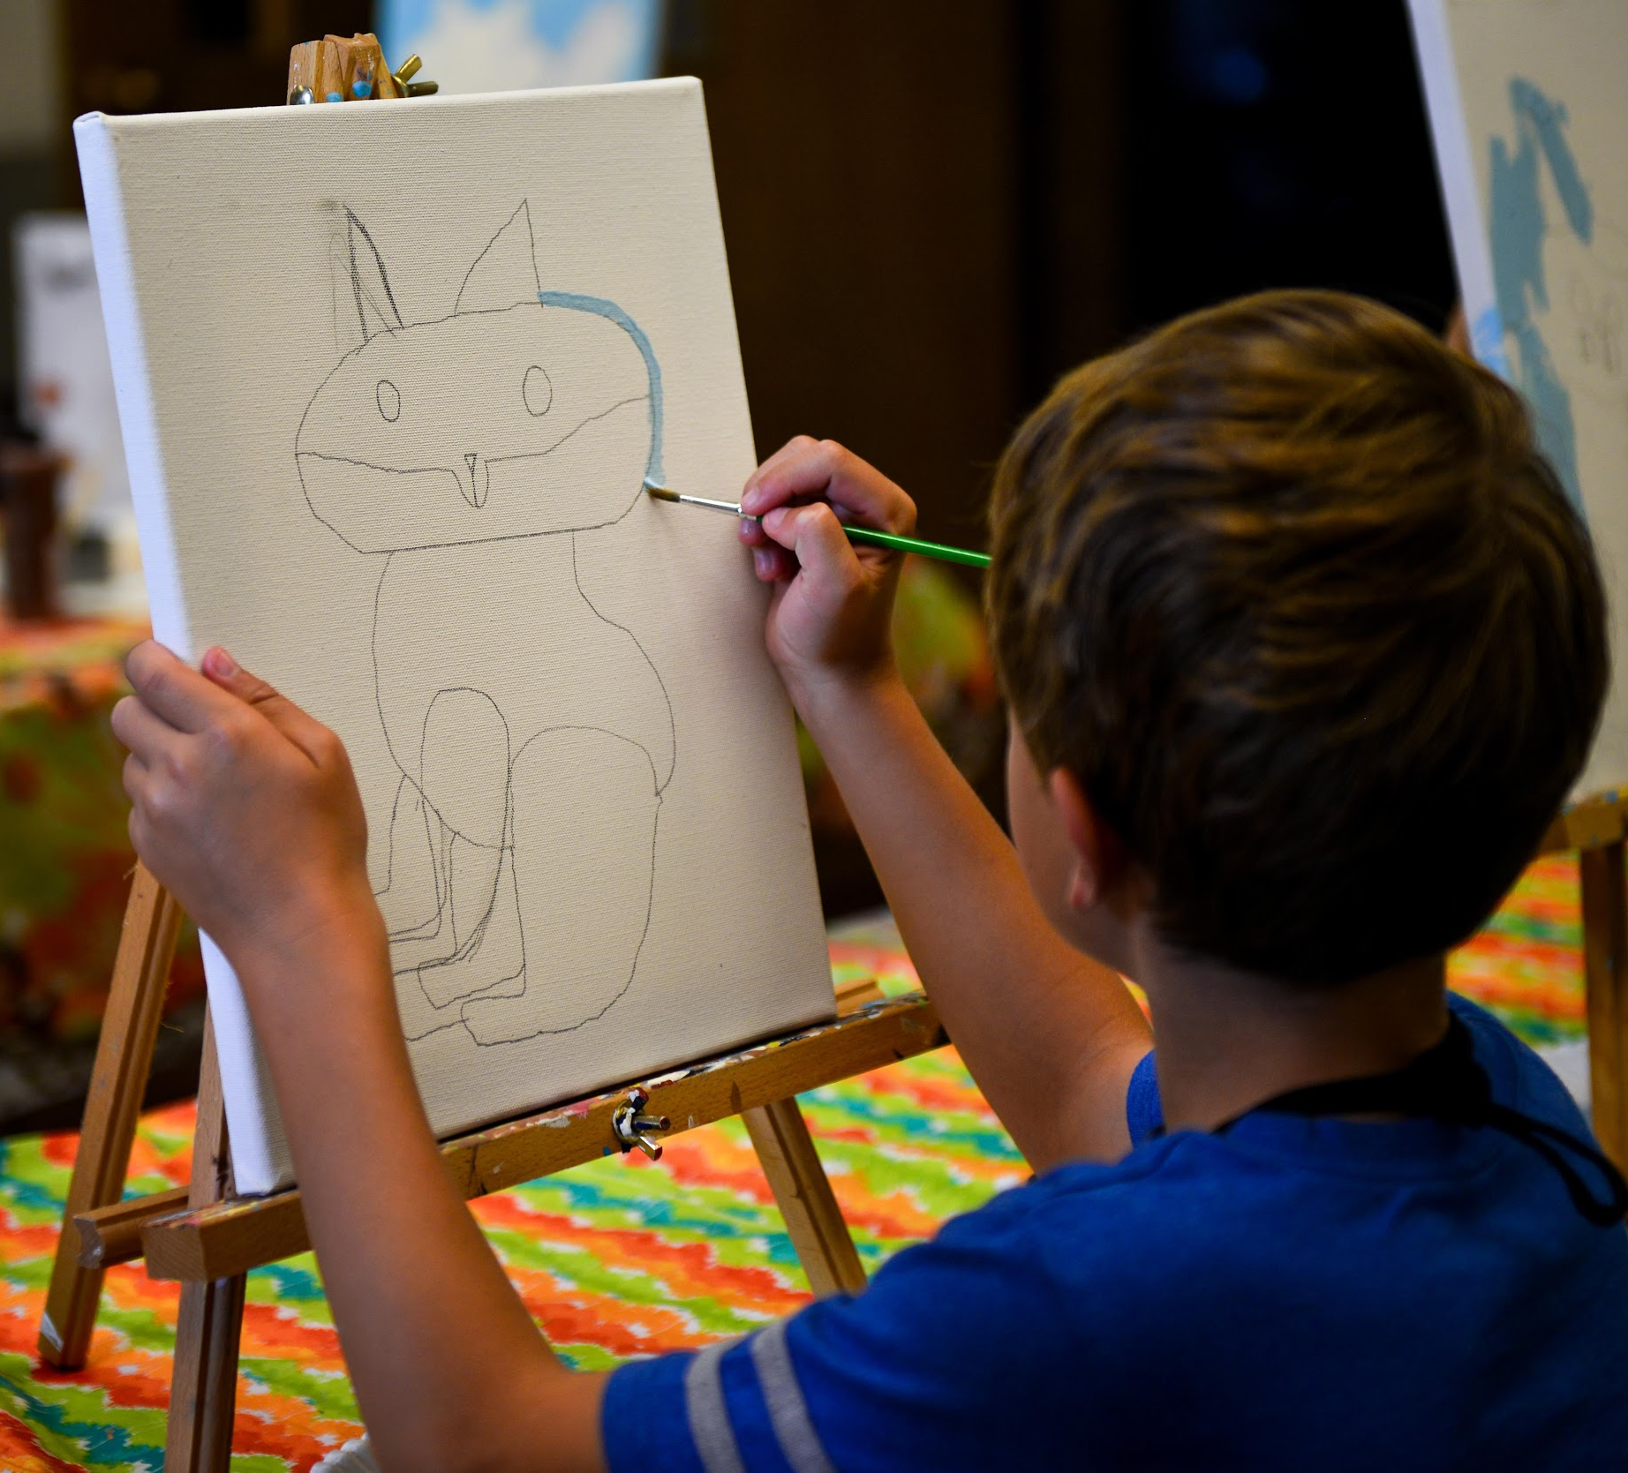
Who is part of our GT program?
Identified Students
Talent Pool Students
Students who are testing in the 80th percentile or higher
Nominated by Teachers, Parents, Peers, & self
On watch Students
Students who are testing in the 70th percentile or higher

Slide 5
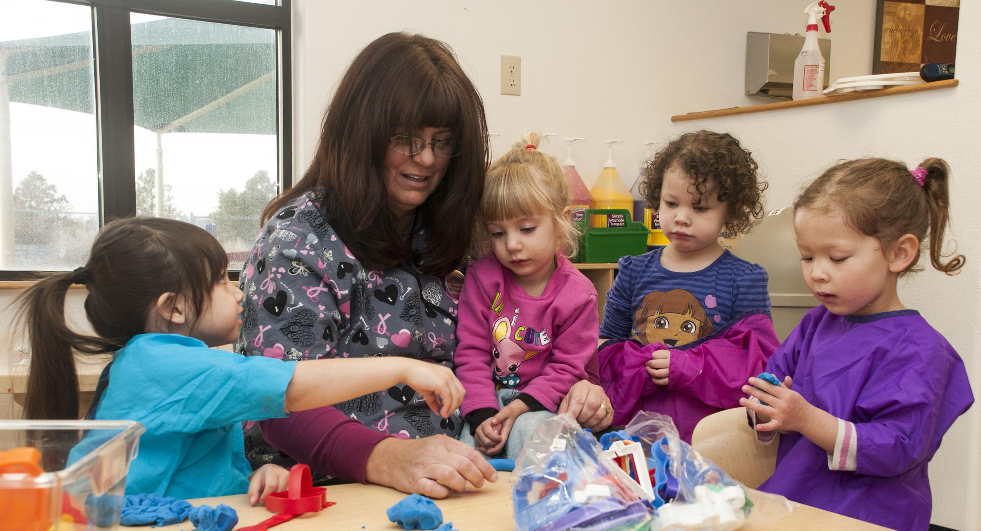
What do we have to offer?
Instant Challenge Enrichment - Grades 2-3
After School Enrichment - Grade 3
Creative Exploration Days - Grades 3-8
Destination Imagination - Grades 4-8
ASU & Trinidad College Courses - Grades 9-12
Independent Study - Grades 7-12
Summer Camp Scholarships - Grades K-12
Subject acceleration - Grades k-12
Universal screening - Grades 2 & 7

Slide 6
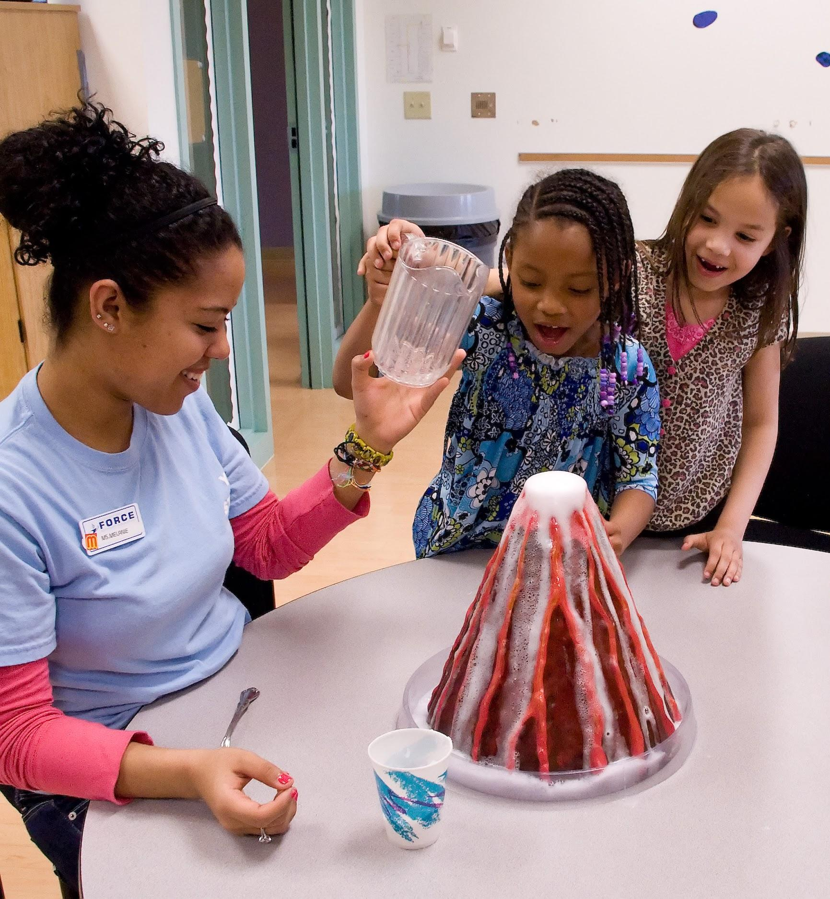
Discussion - Student Needs
What social-emotional needs do you see for your student?
What needs do you see as your student’s academic needs in school?
What extra-curricular activities does your student need?
What needs do you have as an advanced student parent?

Slide 7
Book Study
Parenting Gifted Kids
James Delisle, Ph.D.
The Gifted Teen Survival Guide
Judy Galbraith & Jim Delisle, Ph.D
Parenting Gifted Children 101
Tracy Ford Inman, Ed.D & Jana Kirchner, Ph.D

Slide 8
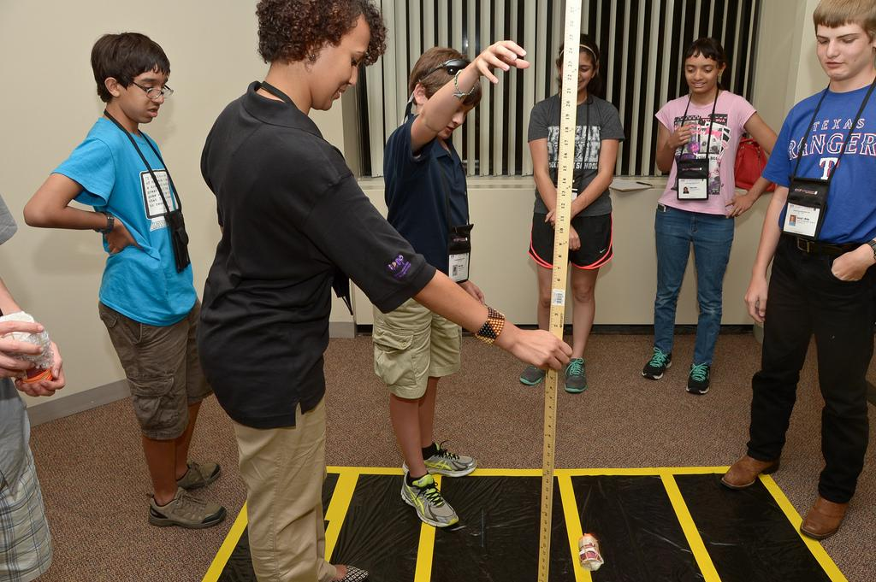
Take Home Activities
Instant Challenge
Makey Makey
Growth Mindset
Temple Grandin Activities
Passion Project
Team/Family Building Games
Social Emotional Activities
Research Projects
What would you like to see?

Slide 9
Next Meeting Dates

